Slide 1

Restaurant Management SYSTEM

Slide 2
Introduction
Restaurant Management System is designed for making the management of the restaurant more organized; give the best service and satisfaction to the customers and also for the employees to accomplish their job easier, more efficient and satisfying by computerizing their works.

Slide 3
Why is it Implemented?
To provide a bug-free application to the admin.
The main objective is to build a secured, robust Restaurant Management System Project where the information of the Restaurant is managed properly.
It maintains the record of food items & menu details efficiently to be easy to access at any time 24*7.
Remove the old fashioned pen and paper.

Slide 4
How is it Implemented?
Functional Microservices
Login
Employee
Item
Employee
Eureka
Api gateway

Slide 5
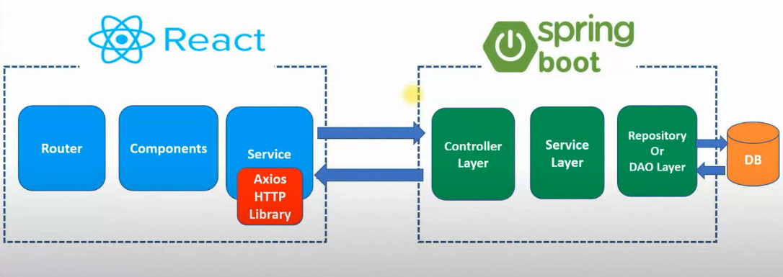
ARCHITECTURE

Slide 6
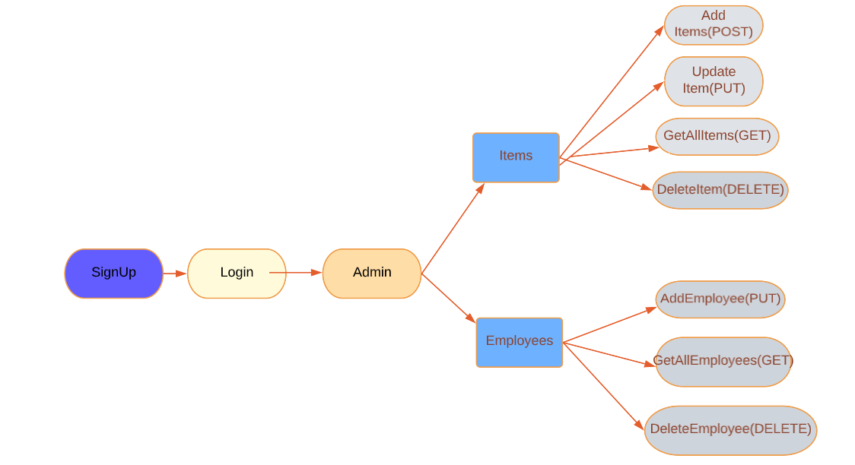

Slide 7
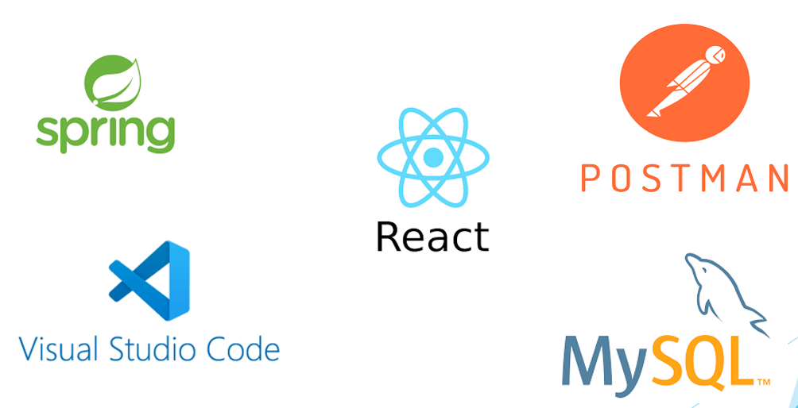
TOOLs USED

Slide 8
CONCLUSION
The urge for restaurant management system is increasing day by day. Through this the ease of access and flexibility of the day to day works in the restaurant is made simpler.
It makes a restaurant work in a structured manner with prior details and quick access to resources.

